Slide 1
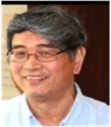
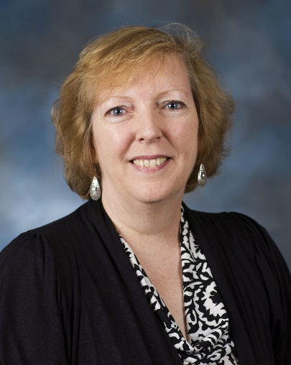
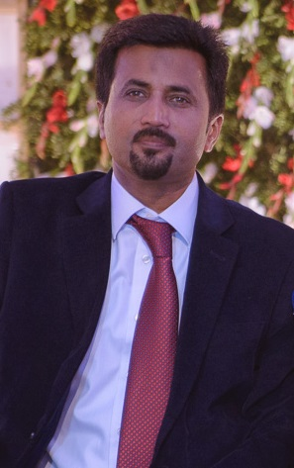
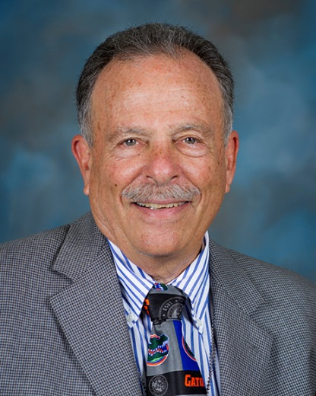
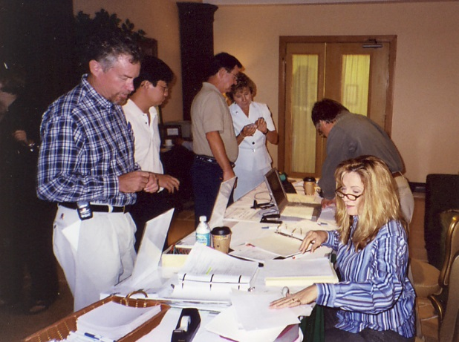
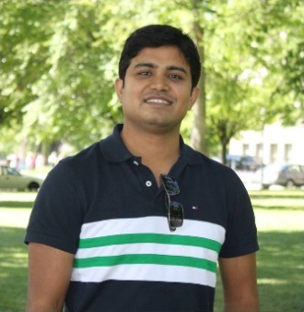
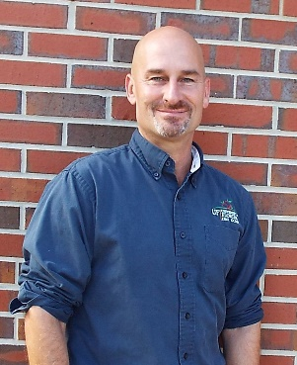
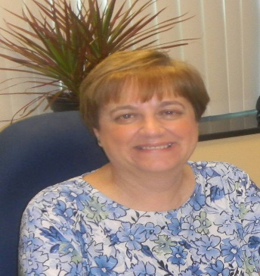


FES Executive Committee
10 voting members + Editor-In-Chief
Rui-De Xue
President FES
Heather McAuslane
President-Elect
Jawwad A Qureshi
Vice President
Phil Stansly
Past President
Graduated
Teresa DuChene
Treasurer & Business Manager
Vivek Kumar
Secretary
Hugh Smith
Member At Large
Nancy Epsky
Member at Large
Reina Tong
Student Member
Christopher Bibbs
Student Member

Slide 2
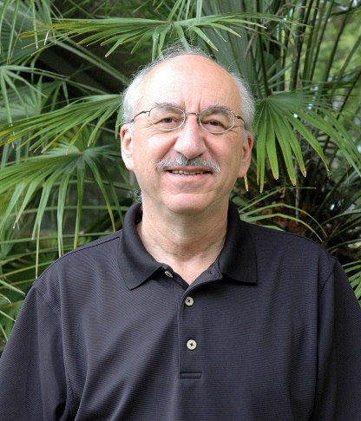
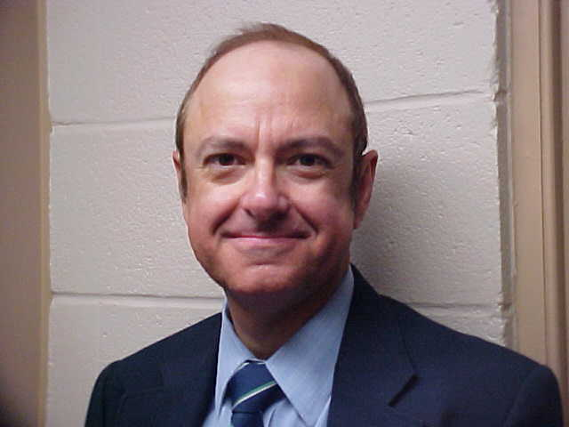

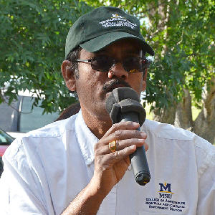
Florida Entomologist
First on the Internet (1994)
John L. Capinera
Editor-In-Chief, Pest Management
James Cilek
Co-Editor
Med & Vet, Insecticide
Kirsten Pelz-Stelinski
Co-Editor
Pathology, Disease transmission
Gadi Reddy
Co-Editor
Ecology, Behavior Biocontrol
Copy Editor: Pam Howell
Business Manager: Teresa Duchene

